Slide 1
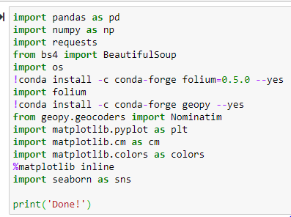
THE Battle of Neighborhood- Final
Libraries

Slide 2
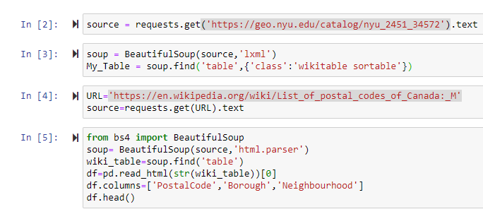
Data Sourcing

Slide 3
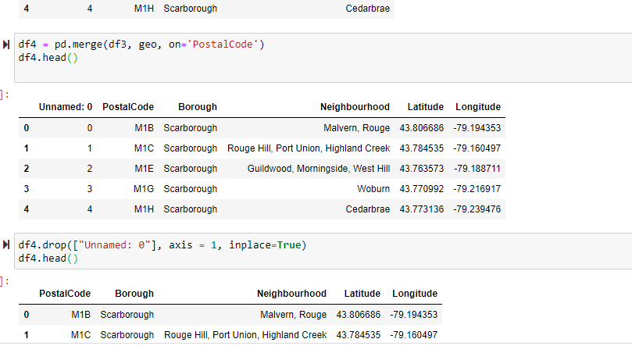
Data Cleaning and Merging

Slide 4
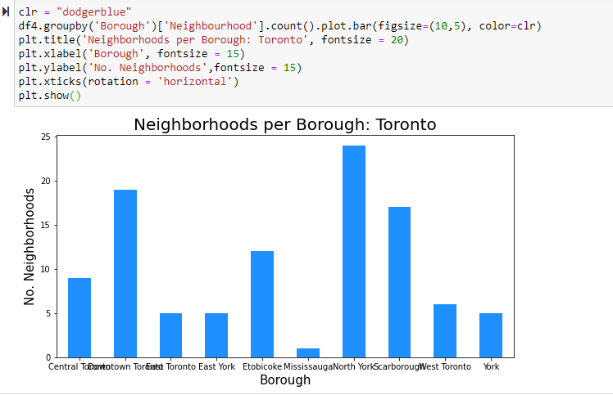
Data Analysis

Slide 5
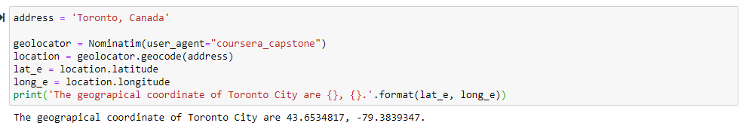
Geo-coordinates

Slide 6
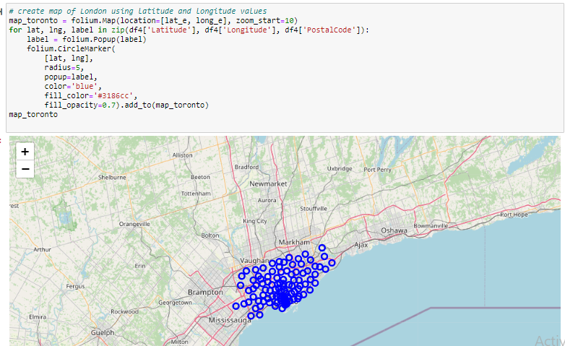
Map for Toronto Neighborhood

Slide 7
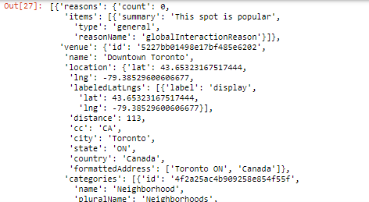
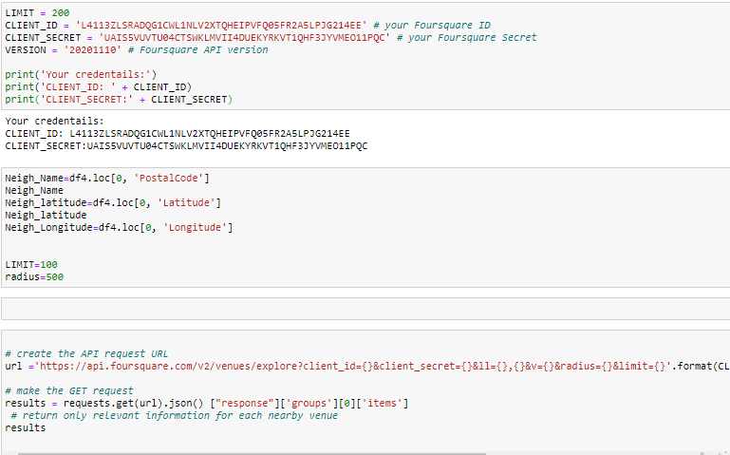
Foursquare API Call to get Venues

Slide 8
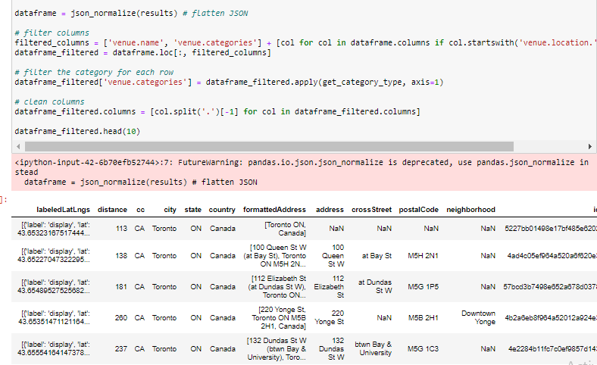
Creation of df for jason file

Slide 9
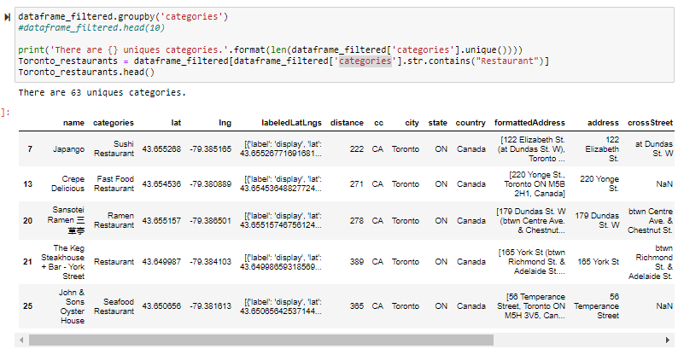
Filtration of df Restaurant wise

Slide 10
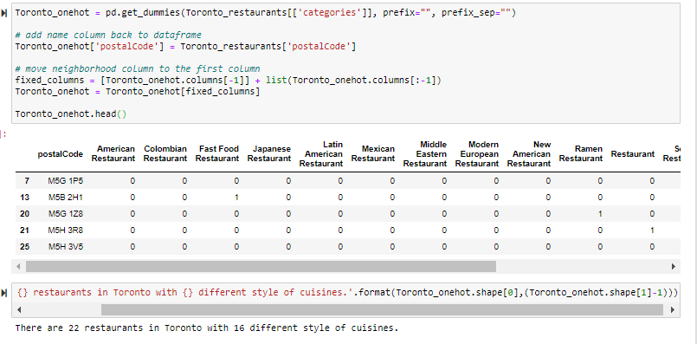
Types of Restaurant and Cousins

Slide 11
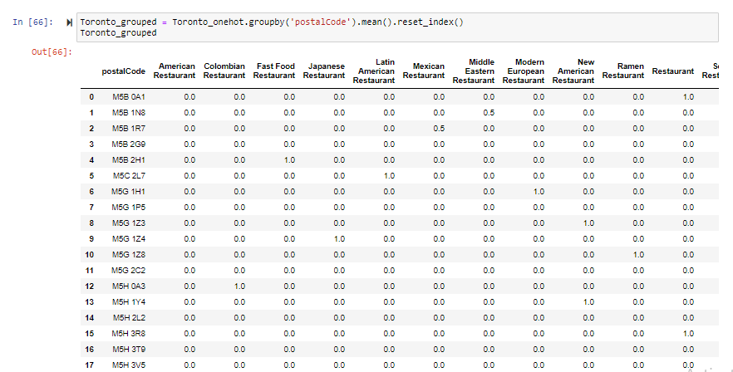
Finding MMM & SD as per Restaurant Types

Slide 12
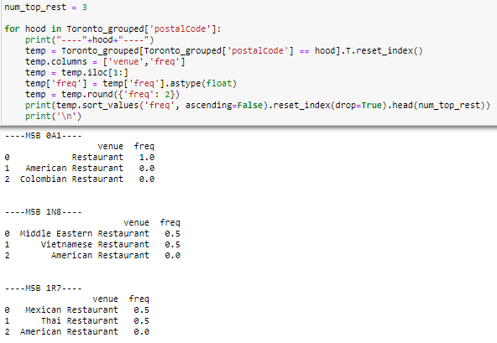
Top 3 restaurant in each area

Slide 13
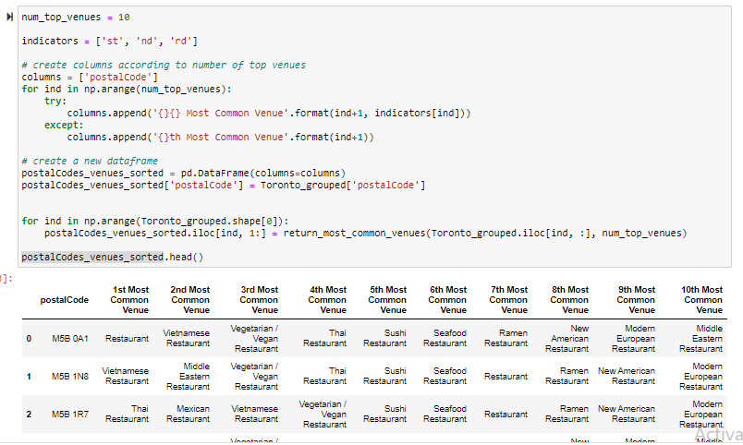
Findings Restaurant as per the ratings

Slide 14
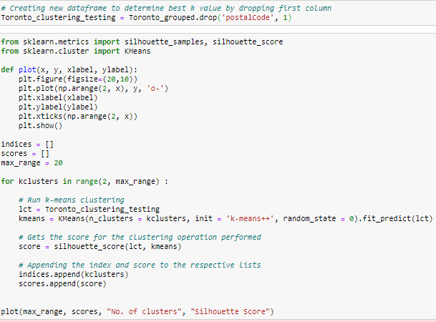
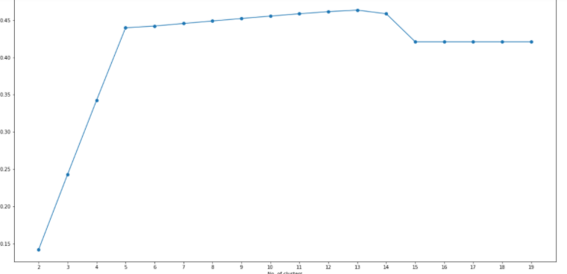
Clustering of Data

Slide 15
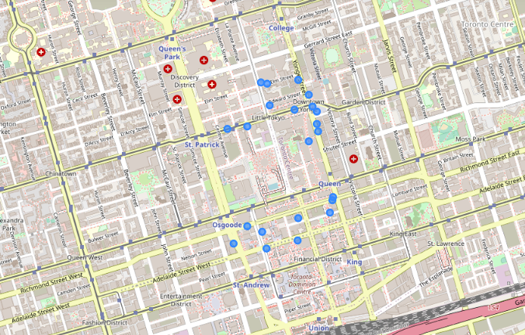
Cluster Map

Slide 16
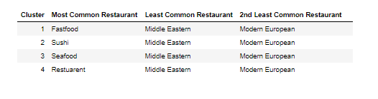
Results on the basis of Clustering

